Slide 1

Meal Stack Canteen Management System
Presented By:
Vaibhav Pophale:258100
Vrushabh Bhandalkar:258218
Guided by: Mr. Vaibhav Verulkar

Slide 2
CONTENTS
• Introduction
• Proposed Solution
• Objectives of the Solution
• Features & Functionalities
• Development Technologies
• Users and Roles
• Use Case Diagrams
•Screenshots & Demo
• Future Scope and Extensions
• Conclusion

Slide 3
Introduction
Traditional canteen systems in educational institutions face several challenges:
• Long Queues : Students waste valuable time waiting to place orders
• Cash Handling: Managing cash transactions leads to reconciliation issues
• Manual Errors: Order processing errors and billing mistakes are common
• No Inventory Tracking: Difficulty in managing daily stock and preventing wastage
• Limited Transparency: No visibility into menu availability or pricing
• No Transaction Records: Students cannot track their spending history
• Inefficient Operations: Manual processes reduce operational efficiency

Slide 4
Proposed Solution
MealStack - A comprehensive digital platform that revolutionizes canteen operations
Key Solutions:
Digital Ordering System Students can browse menu and place orders online from anywhere
Wallet-Based Payments Eliminate cash handling with secure digital wallet system
Real-Time Inventory Management Track stock levels automatically and prevent over-ordering Complete Automation Automated order processing, billing, and receipt generation
Data Analytics Generate insights for better menu planning and decision making

Slide 5
Objectives
The MealStack system aims to achieve the following objectives:
**For Students:**• Reduce waiting time by enabling online ordering
• Provide cashless, convenient payment options
• Offer complete transparency in pricing and availability
• Maintain digital records of all transactions**For Administrators:**
• Streamline order processing and reduce manual errors
• Eliminate cash handling complexities• Enable data-driven decision making through analytics
• Improve operational efficiency and reduce wastage**Overall Impact:**
• Complete digitization of canteen operations
• Enhanced customer satisfaction
• Better resource utilization and cost optimization

Slide 6
Features & Functionalities
Student Features:
• User Registration & Login
• Browse Daily Menu
• Real-time Stock Availability
• Shopping Cart
• Wallet-based Ordering
• Order Status Tracking
• Order History
• Wallet Recharge
• Profile Management
• Change Password

Slide 7
Admin Features:
• Student Management (CRUD)
• Menu Item Management
• Daily Menu Configuration
• Inventory Tracking
• Order Processing
• Mark Orders as Served
• Sales Reports
• Inventory Reports
• Dashboard with Analytics
• Student Analytics

Slide 8
Deployment Technologies
Backend Technologies
Framework: Spring Boot 3.2.2 Programming Language: Java 17 Security: Spring Security 6.2.1 with JWT (JSON Web Token) Database: MySQL 8.0.36 ORM Framework: Hibernate 6.4.1.Final with JPA 3.1 Build Tool: Apache Maven 3.9.6 API Architecture: RESTful Web Services using JSON over HTTP
Frontend Technologies
Framework: React.js 18.2.0 State Management: Redux Toolkit 2.1.0 UI Library: Material-UI (MUI) 5.15.10 Routing: React Router DOM 6.22.0 HTTP Client: Axios 1.6.7 Build Tool: Vite 5.1.4

Slide 9
Software Requirements
Development Tools:
• IDE: IntelliJ IDEA / Eclipse / VS Code
• JDK: Java Development Kit 17 or higher
• Database: MySQL Workbench for database management
• Node.js: Version 18.x for frontend development
• Git: Version control system
Runtime Requirements:
• Application Server: Embedded Tomcat (Spring Boot)
• Port: 8080 (Backend), 5173 (Frontend)
• Browser: Chrome, Firefox, Edge, Safari (latest versions)
Additional Tools:
• Postman : For API testing
• Maven: For dependency management
• npm : For frontend package management

Slide 10
Users and Roles
STUDENT ROLE
Responsibilities:
• Register and login to the system
• Browse daily menu with real-time availability
• Add items to cart and place orders
• Pay using digital wallet • Track order status (Pending/Served)
• View complete order history
• Recharge wallet through payment gateway• Manage profile and change password
ADMIN ROLE
Responsibilities:• Manage student accounts
• Maintain menu item catalogs • Set daily menus with quantities
• Process and serve orders
• View pending and completed orders
• Generate sales and inventory reports
• Monitor system analytics• Configure system settings

Slide 11
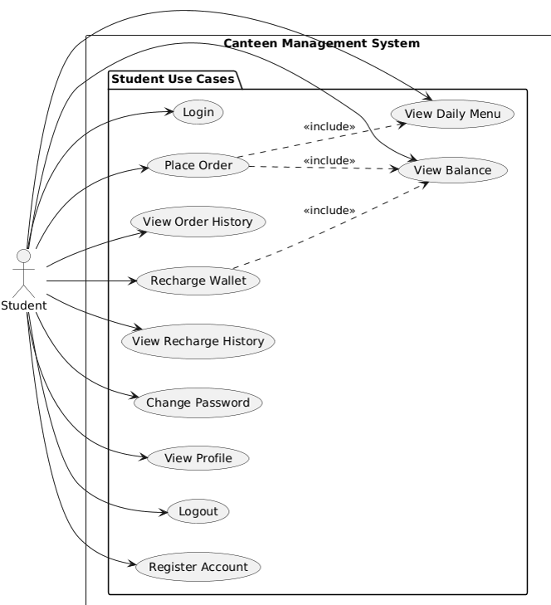
Use Case Diagram

Slide 12
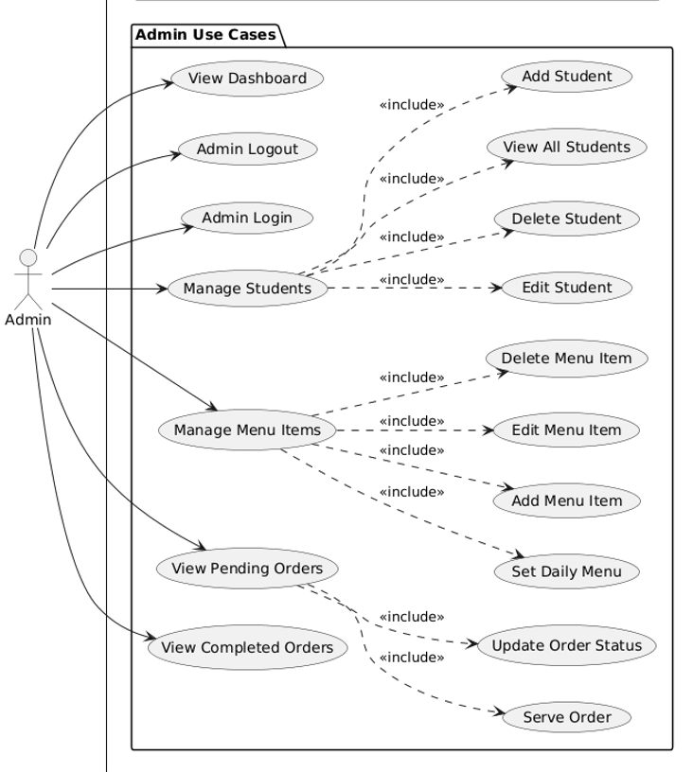

Slide 13
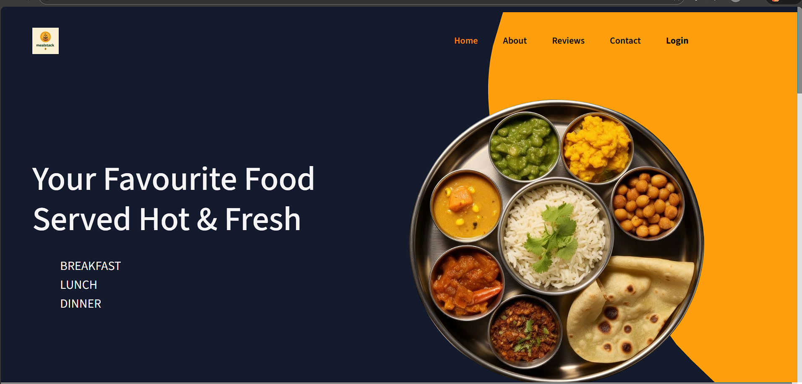
Screenshots

Slide 14
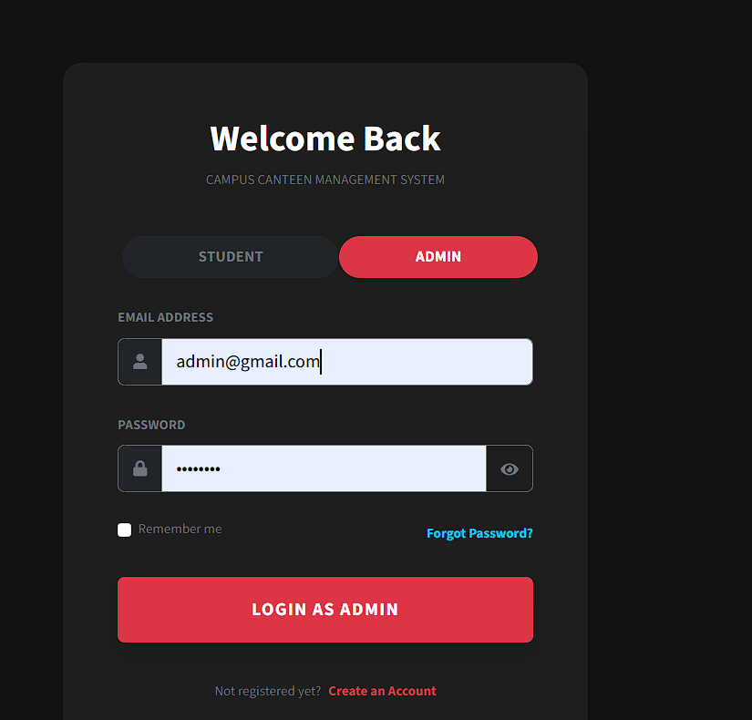

Slide 15
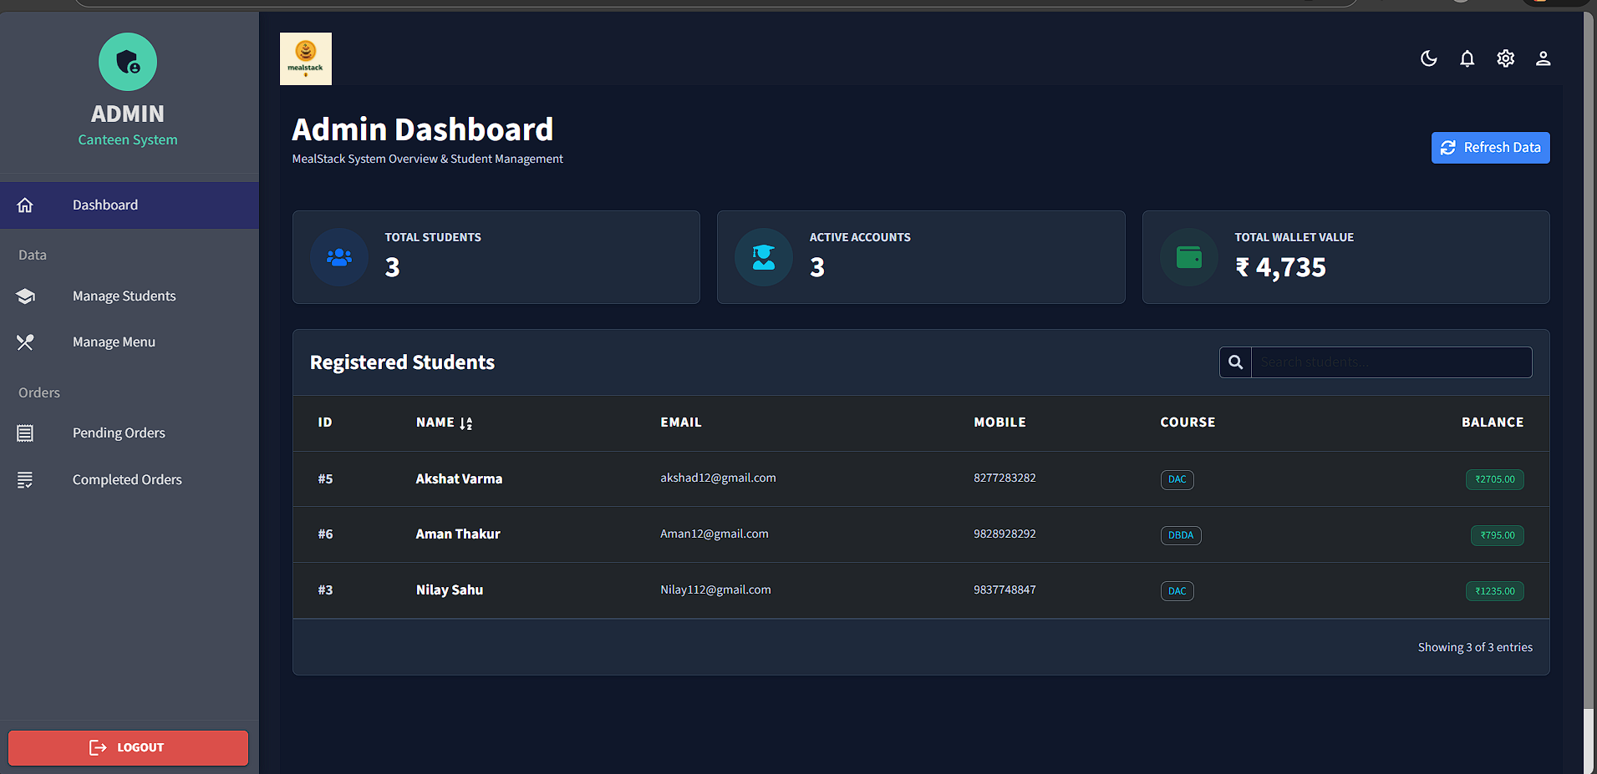

Slide 16
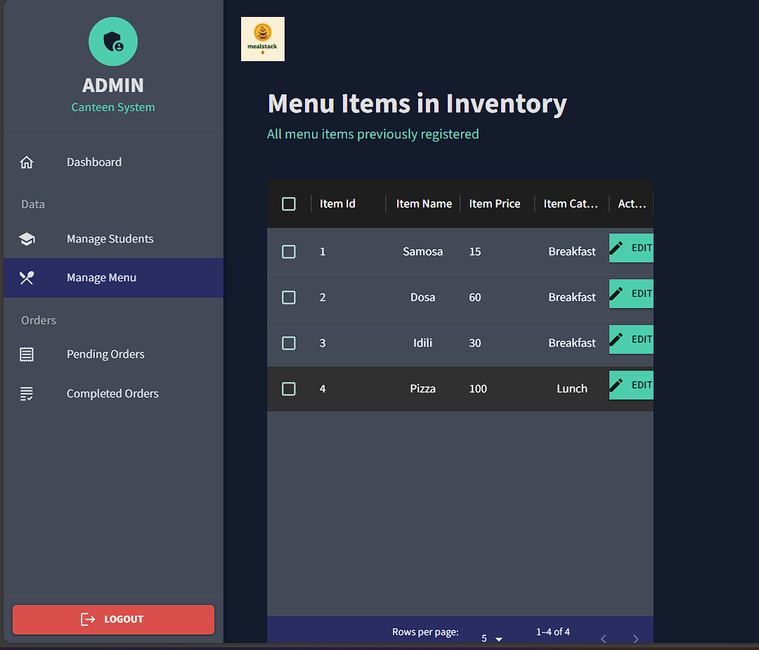

Slide 17
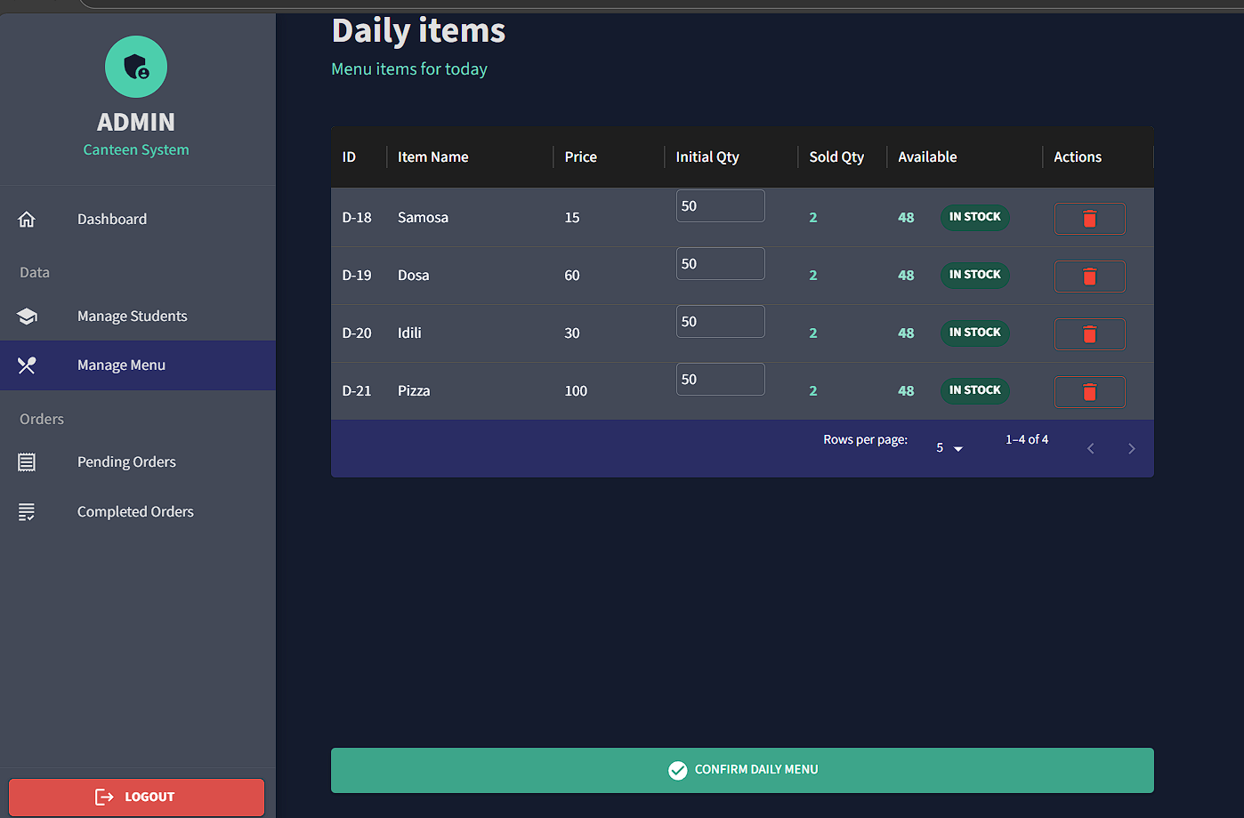

Slide 18
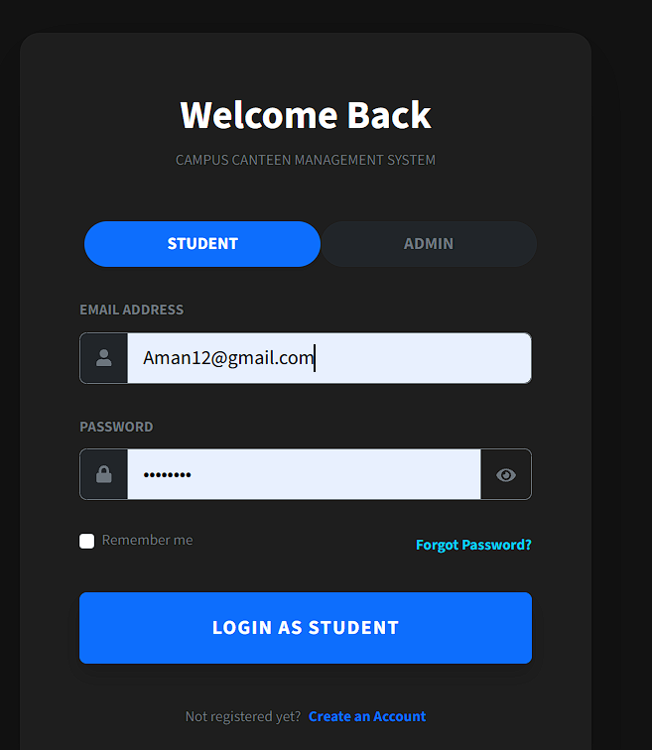

Slide 19
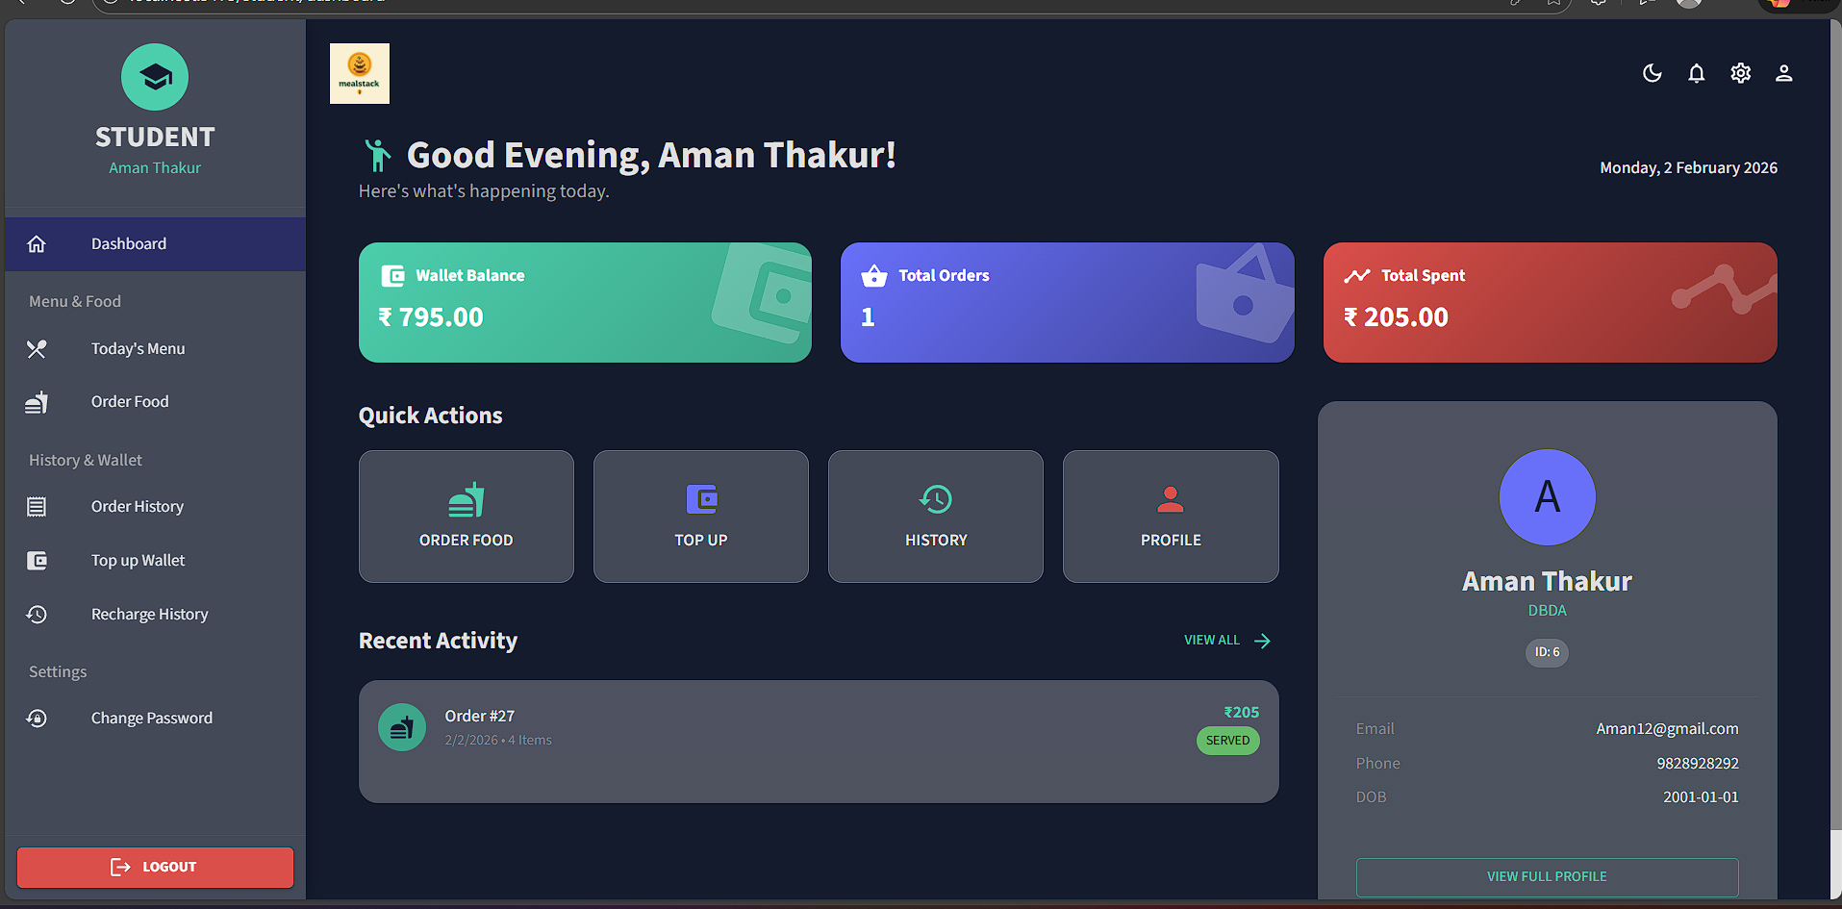

Slide 20
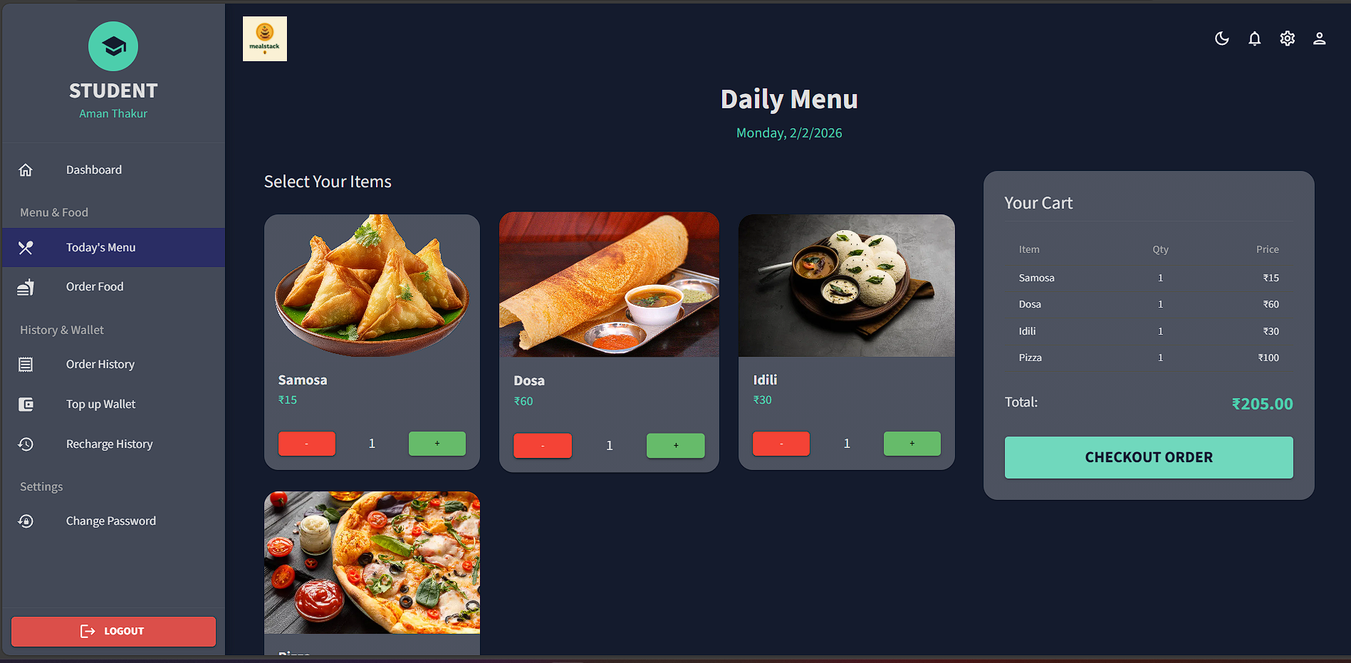

Slide 21
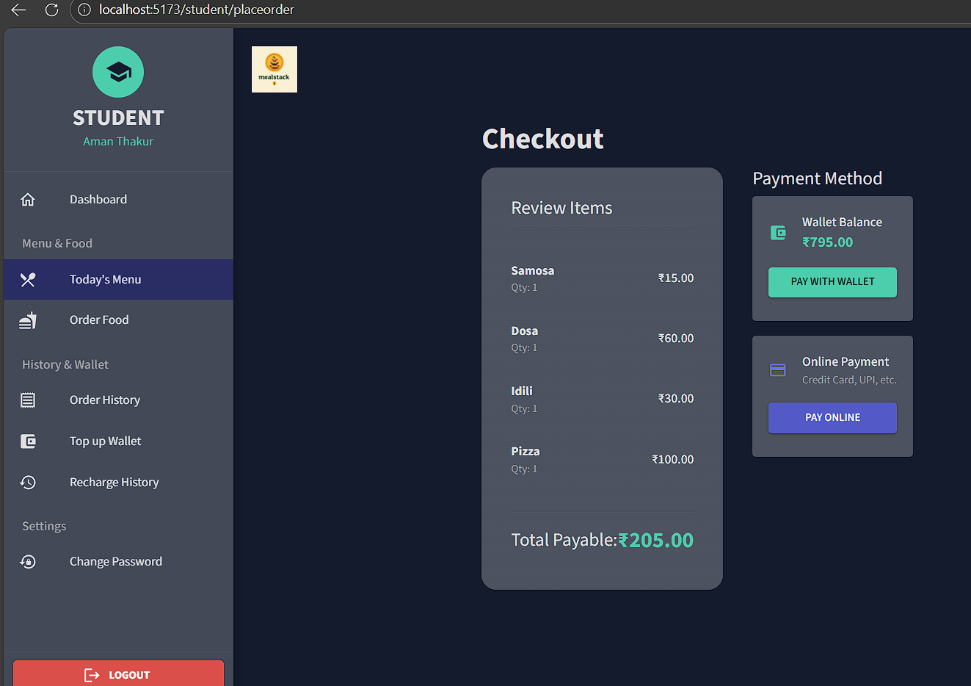

Slide 22
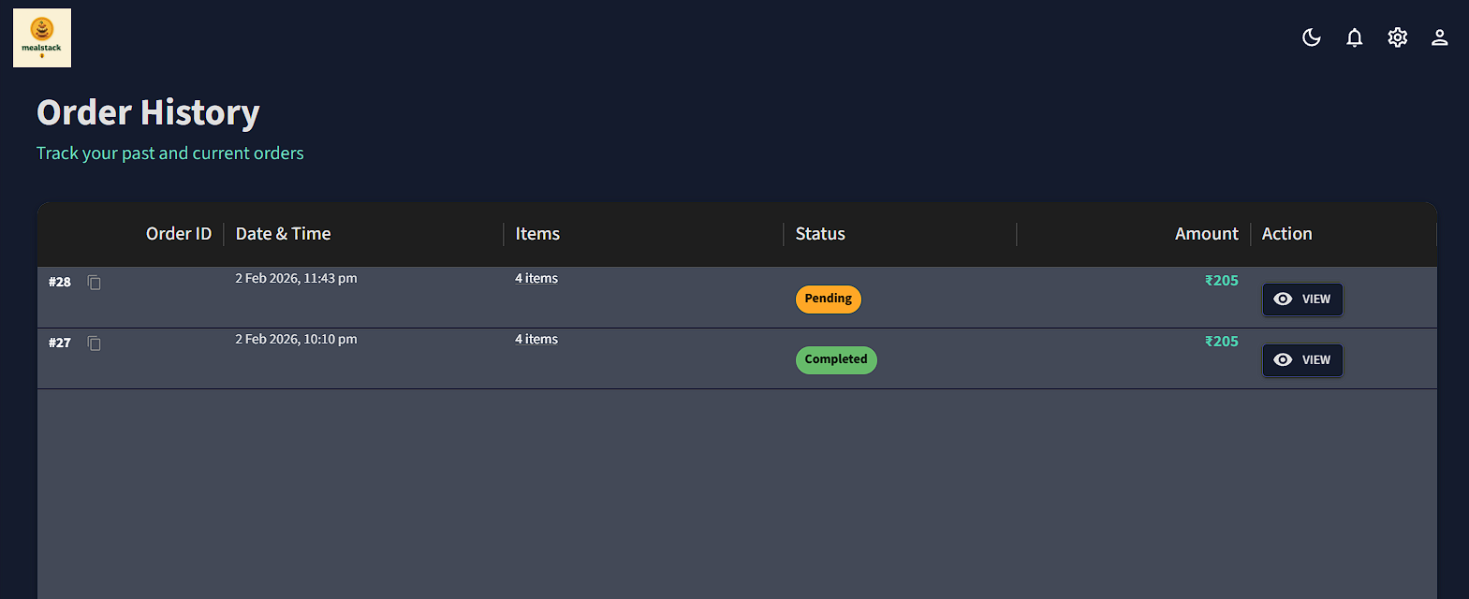

Slide 23
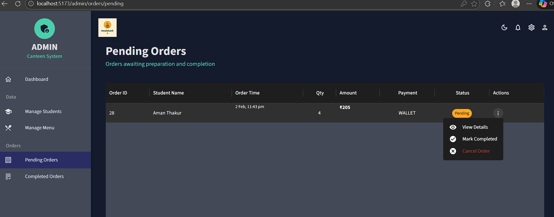

Slide 24
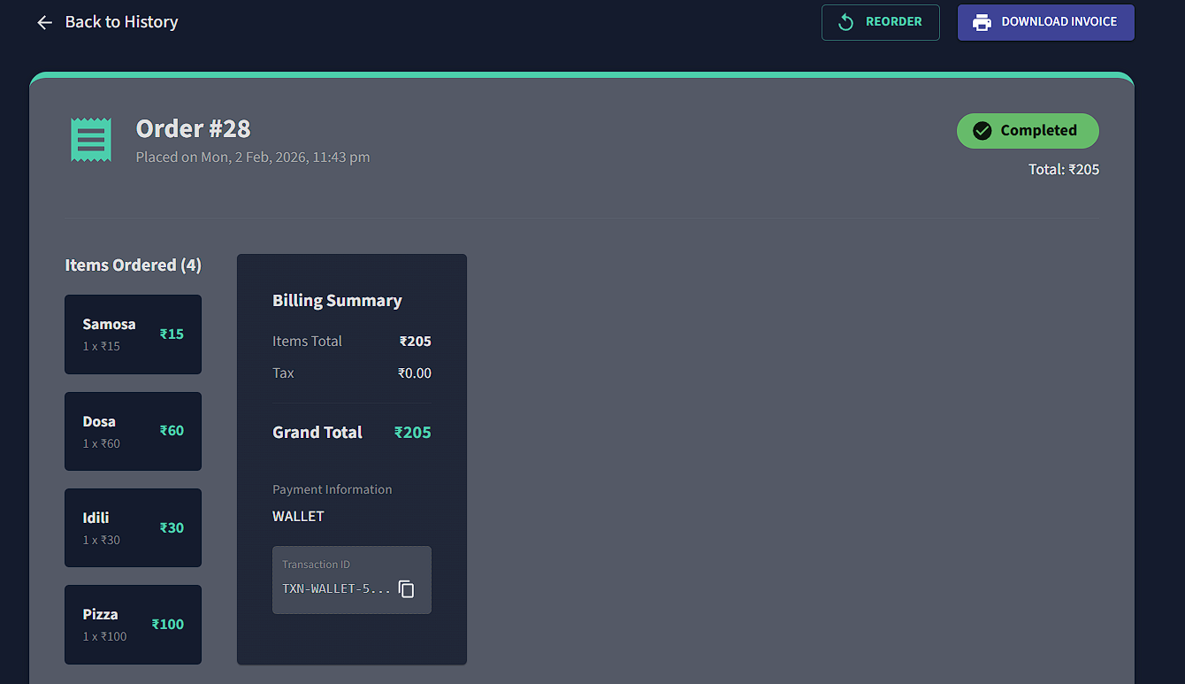

Slide 25
Future Scope
Planned Enhancements:
Advanced Features:
• QR Code-based order pickup system
• Push notifications for order updates
• AI-based menu recommendations
• Nutritional information tracking
• Pre-ordering for future dates
• Subscription-based meal plans
Mobile Applications:• Native iOS and Android apps
• Progressive Web App (PWA)
• Offline menu viewing capability
Analytics & AI:• Predictive analytics for demand forecasting
• Machine learning for inventory optimization
• Automated seasonal menu suggestions
Integrations:• Integration with institutional ERP systems
• Student ID card integration• Biometric authentication
• Multi-language support
• Cloud-based deployment• API for third-party integration

Slide 26
Conclusion
MealStack successfully modernizes traditional canteen operations by delivering a fully digital, secure, and user-friendly platform. By eliminating cash handling, reducing manual errors, and accelerating order processing from minutes to seconds, the system significantly improves efficiency and transparency. Students benefit from convenient ordering, reduced wait times, and clear transaction tracking, while administrators gain streamlined operations, improved inventory control, and actionable insights through analytics. Built using Spring Boot, React, Redux, and secure JWT-based authentication, MealStack demonstrates a scalable, maintainable, and robust architecture. Overall, the project represents a successful digital transformation initiative that enhances operational efficiency, user satisfaction, and institutional effectiveness.

Slide 27
Thank You!!

